Slide 1
PJM Footprint Roundtable
The Future of Dynamic Pricing, Price Responsiveness Demand, Demand Response in the PJM Footprint
Betty Ann Kane, Chairman
DC Public Service Commission
September 27, 2017

Slide 2
The Retail Electric Competition and Consumer Protections Act of 1999
Required Pepco to sell its power plants-became a distribution company only
Commission regulates Pepco’s distribution rates and service
Commission prohibited from regulating the price of electricity
Consumers may purchase electricity from any licensed supplier
Customers who don’t choose are placed in Standard Offer Service- Pepco is the currently designated administrator
Price of Standard Offer Service is determined by competitive auctions under Commission rules
All suppliers covered by Commission rules for consumer protection

Slide 3
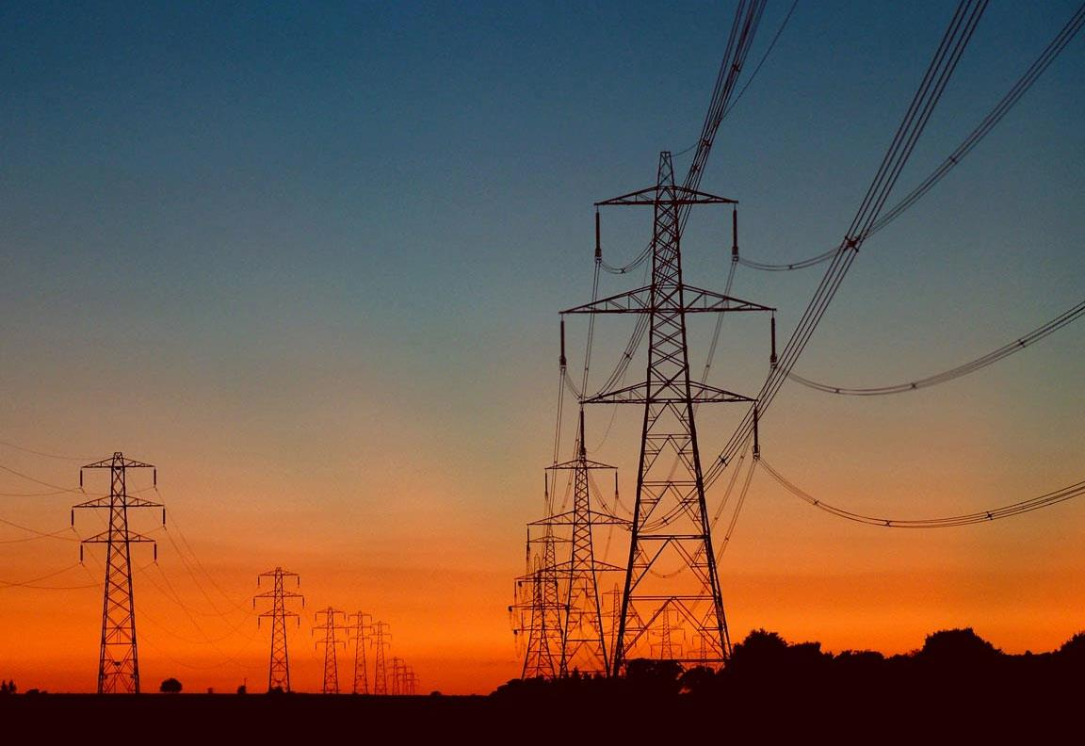
Customer Choice of Electricity Supplier
Customers who have chosen a competitive supplier:
13% of residential customers
35% of commercial customers
71% of actual kwh sold are by competitive suppliers

Slide 4
Market Shares for Electricity Load (MW)

Slide 5
Pepco-DC Direct Load Control
Residential Central A/C
Year | No. of Participants enrolled end of the year | No. of Devices installed | No of active customers** at the end of the year
2012 | N.A. | 7,301 | N. A.
2013 | 24,080 | 27,393 | 22,107
2014 | 26,669 | 30,693 | 23,746
2015 | 27,821 | 32,200 | 25,385
2016 | 27,992 | 32,338 | 25,369

Slide 6
PJM Delivery Year (Not calendar Year) | MW bid into RPM and cleared | Capacity Revenue from PJM
2013/2014 | 16.6 | $60,590
2014/2015 | 18.0 | $161,859
2015/2016 | 18.0 | $1,090,556
2016/2017 | 17.4 | $756,595**
2017/2018 | 18.4 | $805,920**
2018/2019 | 18.0 | $292,458**
2019/2020 | 18.0 | $66**
2020/2021 | 17.4* (only partial cleared)

Slide 9
ACTUAL DIRECT LOAD CONTROL COSTS (2011 - 2015)
Program Spending | $15,553,038.06
ARRA Funds | $3,715,118.03
PJM Revenue | $ (845,394.52)
Cost of Capital | $ 948,249.97
Net in Regulatory Asset | $ 11,940,776.28

Slide 10
Total Retail Sales (MWH) and the SOS Portion

Slide 11

The End
Public Service Commission of the District of Columbia
1325 G Street, NW
Suite 800
Washington, D.C. 20005
(202) 626-5100
www.dcpsc.org

